Slide 1
Neural POS Tagger
NLP Project:
TEAM Name: Lemmatizer
Tirth Pandit (2019201017)
Pratik Tiwari (2019201023)
Mentor: Ujwal Narayan
Github Repo: https://github.com/pratikiiith/Neural-POS-Tagger-NLP.git

Slide 2
Content
Problem Statement
Project Timeline
Dataset
Corpus details
Type of data Files
Baseline Model
Papers Referred
HMM details
Implementation
CRF Details
Implementation
Results
Accuracy on each Corpus
F1 Score on each Corpus
Error Analysis HMM
Error Analysis CRF
Neural Model
Papers Referred
Embeddings used
Dual Embedding + LSTM
Model Details and Implementation
Hyper Parameters Tuning
Accuracy and Loss on complete dataset
Final Test set Accuracy
Error Analysis
correct vs wrong prediction
Dual Embedding + BILSTM
Model Details and Implementation
Hyper Parameters Tuning
Accuracy and Loss on complete dataset
Final Test set Accuracy
Error Analysis
correct vs wrong prediction
Result on Each corpus
Evaluation Metrics LSTM
Evaluation Metrics BILSTM
Accuracy comparison
F1 Score comparison

Slide 3
Problem Statement
POS tagging is the process of tagging the words with their categories that best suits the definition of the word as well as the context of the sentence. It is often the first step for many NLP applications.
Aim of the project is to create the Neural network based POS Tagger for Gujrati Language.
In general and Gujrati Language in particular is not a very widely explored language in NLP Tasks. Also morphological complexity of the language makes it hard to develop NLP applications around it.
Previous Work has been done in the area of POS Tagging in Gujrati Language which uses different approaches like HMM (Hidden Markov Models) and CRF( Conditional Random Fields)
Purpose of this Project also includes the comparisons between these classical approaches and Neural POS Tagger

Slide 4
Project Timeline
Mid-Evaluation / Interim Report
Final Report
Deciding Neural Arch. and experimental setup
Testing/Tuning and bug Fixing
25th March 2021
25th April 2021
Implementation HMM and CRF
Implementation of Neural POS Tagger

Slide 5
Dataset
Gujarati Monolingual Text Corpus ILCI-II
30,000 sentences of general domain.
The translated sentences have been POS tagged according to BIS (Bureau of Indian Standards) tag set.
https://www.ldcil.org/Download/Tagset/LDCIL/5Gujrati.pdf
It has eleven primary tags and similarly it divides in sub tags. Main classes of Tag-set are:
Demonstrative (DM) , Post Position (PSP) , Noun (NN)
Adverb (RB) , Verb (V) , Pronoun (PR)
Conjunction (CC) , Particles (RP) , Quantifier (QT)
Adjective (JJ) , Residual(RD).

Slide 6
Data Set Details:
guj_art and culture_sample1.txt
guj_economy_sample2.txt
guj_entertainment_sample3.txt
guj_philosophy_sample4.txt
guj_religion_sample5.txt
guj_science and technology_sample6.txt
guj_sports_sample7.txt

Slide 7
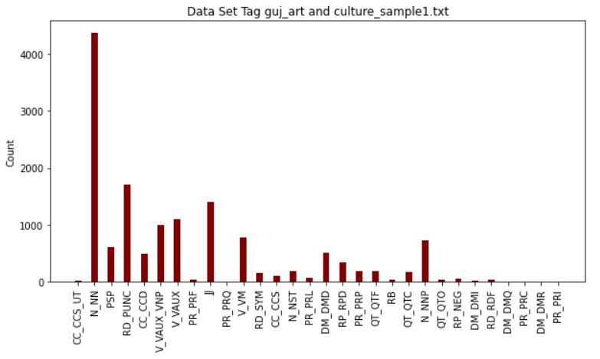
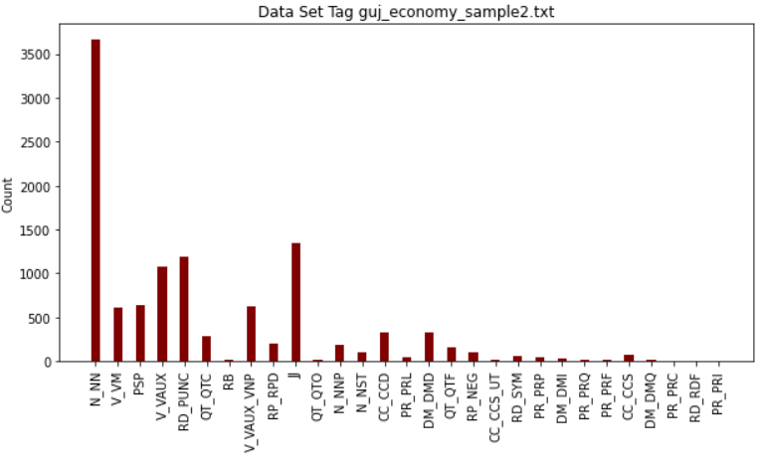
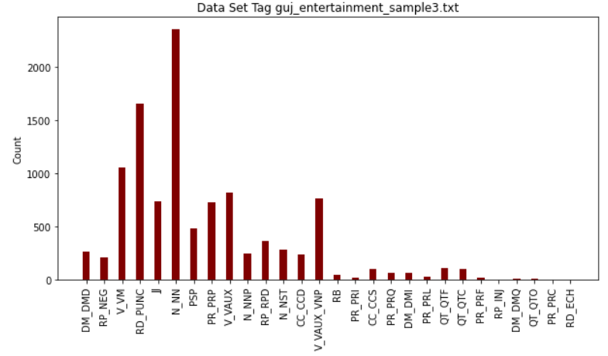
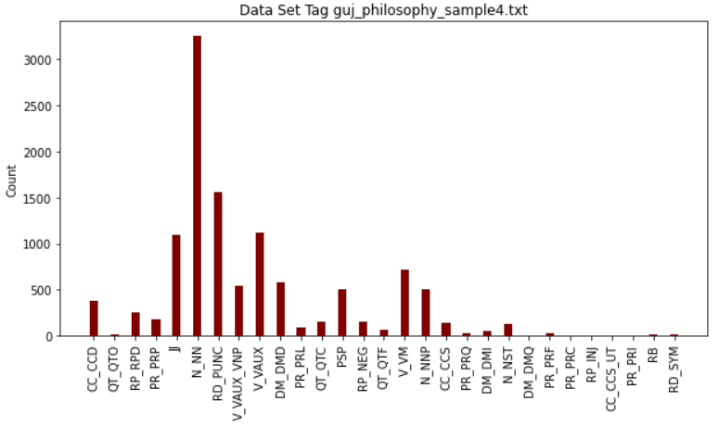

Slide 8
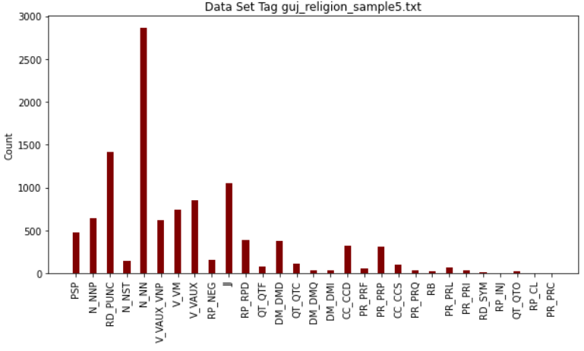
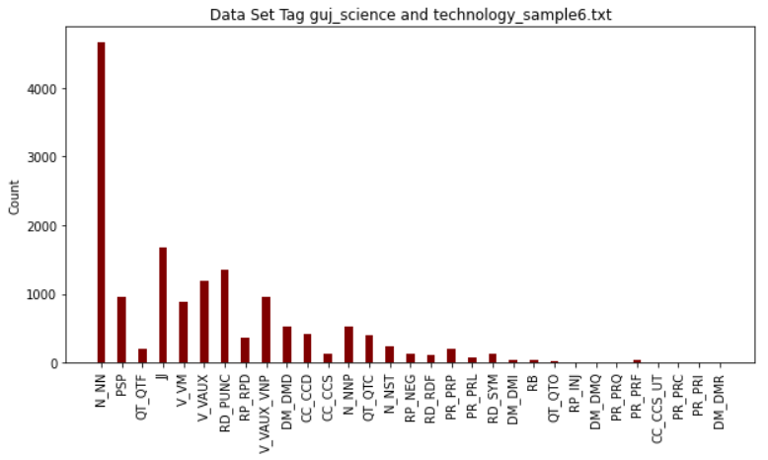
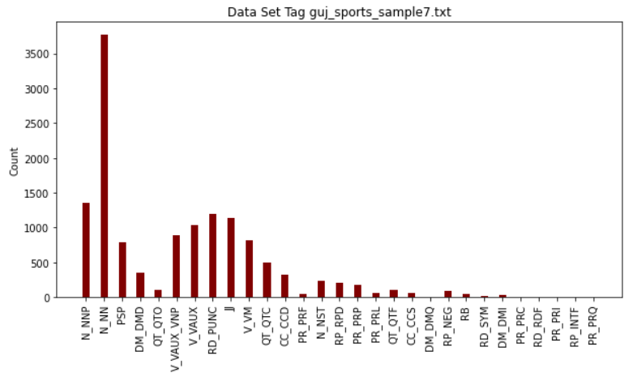

Slide 9
Baseline Model
1. Part-Of-Speech Tagging for Gujarati Using Conditional Random Fields ( Chirag Patel and Karthik Gali )
This paper describes a CRF machine learning algorithm for Gujarati Part of Speech Tagging.
This CRF model when provided with good features gives accuracy much better than other models.
The intuition presented in this paper is to convert the linguistic rules specific to Gujarati in to features which then provided to CRF. This method make use of advantages of both statistical and rule based approach.
2. A Statistical Method for Evaluating Performance of Part of Speech Tagger for Gujarati ( Pooja M. Bhatt, Amit Ganatra )
This article presents POS tagging for Gujarati textual content the use of Hidden Markov Model. Using Gujarati text annotated corpus for training checking out statistics set are randomly separated. 80% accuracy is given by model. It discusses 2 approaches for POS tagging.
One is Supervised POS Tagging which requires tagged dataset this is used for studying details about rule sets, word-tag frequencies, tag gadgets, and so forth. The overall performance of supervised pos tagger fashions boom with enhancement of corpus’s length.
Second is Unsupervised POS Tagging The Model does now not require tagged dataset. By applying computational techniques together with the transformation rules, Algorithm to generate tag clusters.

Slide 10
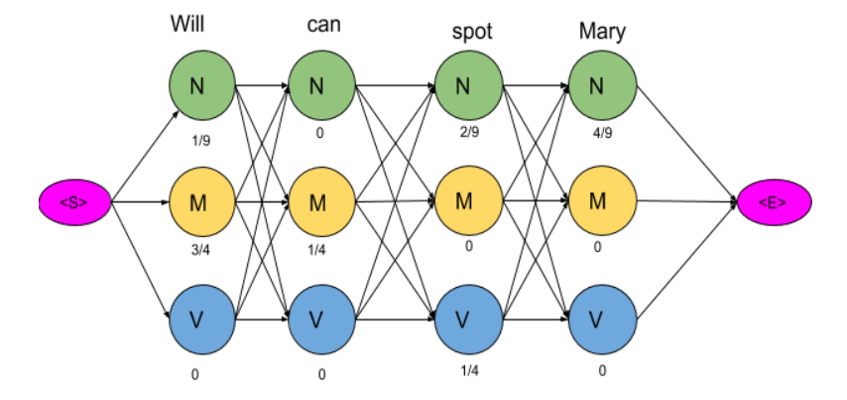
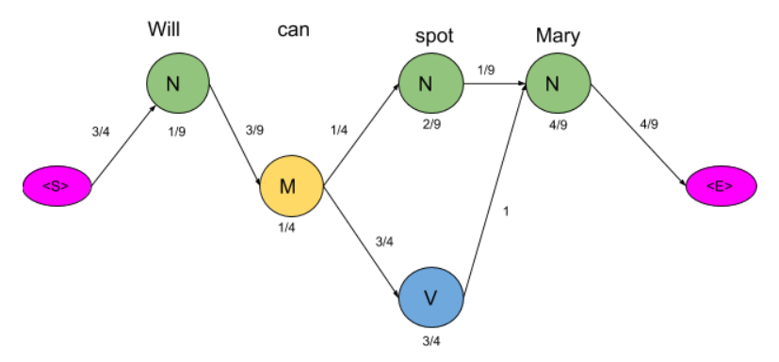
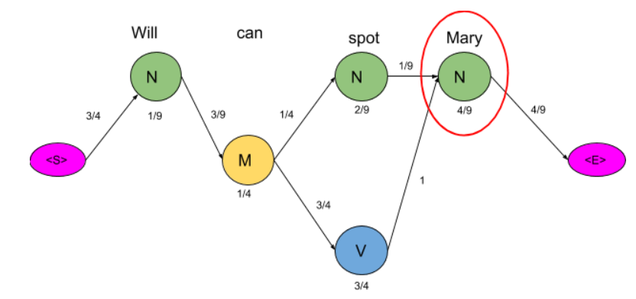
HMM Implementation + Viterbi
1) Data processing by extracting unique words from the training data.
2) Initially set count of each tag as zero and then count of occurrence of each tag.
3) Initialize and update Emission & Transmission matrix.
4) For testing data compute viterbi decoding.
6) Remove the path with minimum probability and backtrack for given sentence

Slide 11
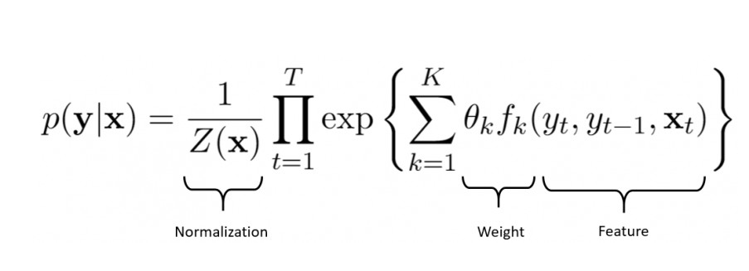
CRF Implementation
A CRF is a sequence modeling algorithm which is used to identify entities or patterns in text, such as POS tags
These models take into account previous data for which we use features which are generated from the data to feed into the CRF.
We define feature functions that express certain characteristic of the sequence that the data point represents , Ex : The tag sequence noun -> verb -> adjective
Y is the hidden state and X is the observed variable

Slide 12
CRF Implementation
The weight estimation is performed by maximum likelihood estimation(MLE) using the feature functions we define.
Feature Function
Word
Lowercase word
Prefixes and suffixes of the word of varying lengths
If word is a digit
If word is a punctuation mark
The length of the word - no. of characters
(since shorter words are expected to be more likely to belong to a particular POS)
Stemmed version of the word,
Features mentioned above for the previous word, the following word, and the words two places before and after

Slide 13
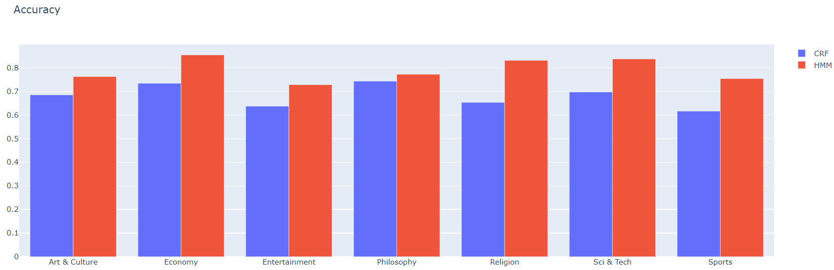
Accuracy: HMM vs CRF

Slide 14
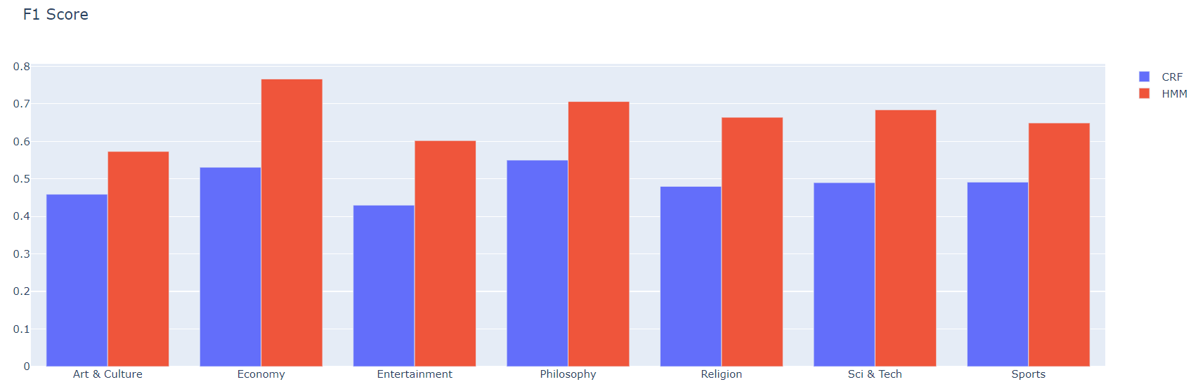
F1-Score : HMM vs CRF

Slide 15
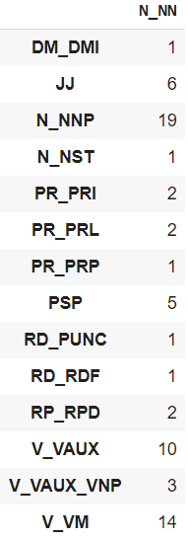
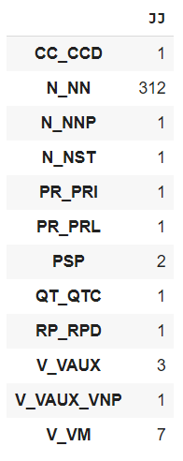
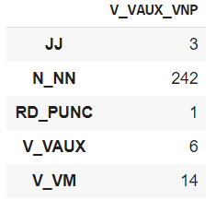
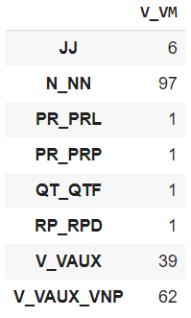
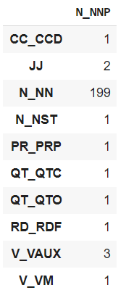
Error Analysis HMM

Slide 16
Row -> Actual Column -> Predicted
HMM Error Analysis on complete dataset

Slide 17
Neural based Model
A Neural Network Model for Part-Of-Speech Tagging of Social Media Texts This paper presents a neural network model for Part-Of-Speech (POS) tagging of User-Generated Content (UGC) such as Twitter, Facebook and Web forums. The proposed model uses both character and word level representations. Character level representations are learned during the training of the model through a Convolutional Neural Network (CNN). For word level representations paper describes combine several pre-trained embeddings (Word2Vec, FastText and GloVe ). To tackle the issue of the poor availability of annotated data on social media paper uses transfer learning . Neural model that we use for Transfer Learning experiments is based on bidirectional hierarchical Gated Recurrent Units (GRUs). In this case, the source domain is the some well established language and the target domain is the social media text of the same language. It also uses 2 types of feature representations : character level and word level. CNN architecture is used for character level feature generation and Pretrained word embeddings are used for word level representation.
Part-Of-Speech Tagging using Neural network by Ankur Parikh This paper presents two novel approaches of POS tagging using Neural network for Hindi language and compares them with two other machine learning approaches, HMM and CRF. In this paper, a single-neuro tagger, a Neural network based POS tagger with fixed length of context chosen is presented . Then, a multineuro tagger which consists of multiple single-neuro taggers with fixed but different lengths of contexts is presented. Multineural tagger performs tagging by voting on the output of all single-neuro taggers.

Slide 18
Neural based Model
Neural Network based Parts of Speech Tagger for Hindi
In this paper, Artificial Neural Network for Hindi parts of speech tagger has been used. Uses Rule base POS Tagger as the initial classifier and on top of it trains the Neural network to finally classify the words in tag classes.
The Rule based POS tagger tag the POS by simply using the Lexicon. The outcome of the Rule based POS Tagger is not perfect, for correction and accuracy it finally passes through the ANN based POS tagger. Here the ANN is used for pattern Recognition of corpus to identify and correct the POS tagging
GENERAL REGRESSION NEURAL NETWORK BASED POS TAGGING FOR NEPALI TEXT
This article presents Part of Speech tagging for Nepali text using General Regression Neural Network (GRNN). The corpus is divided into two parts viz. training and testing. The network is trained and validated on both training and testing data.
It is observed that 96.13% words are correctly being tagged on training set whereas 74.38% words are tagged correctly on testing data set using GRNN. It compares GRNN based POS Tagger with Viterbi Algorithm with conclusion that GRNN POS tagger is more consistent than the traditional Viterbi decoding technique. Transition and Emission probability matrices are constructed from the training data and this both matrices are used to calculate the feature of the each word which is then used as input to GRNN.

Slide 19
Embeddings
Word embeddings are a type of word representation that allows words with similar meaning to have a similar representation
Embedding layer is learned jointly with a neural network model on a specific natural language processing task
It requires that document text be cleaned and prepared such that each word is one-hot encoded.
The size of the vector space is specified as part of the model, such as 50, 100, or 300 dimensions.
The vectors are initialized with small random numbers. The embedding layer is used on the front end of a neural network and is fit in a supervised way using the Backpropagation algorithm

Slide 20
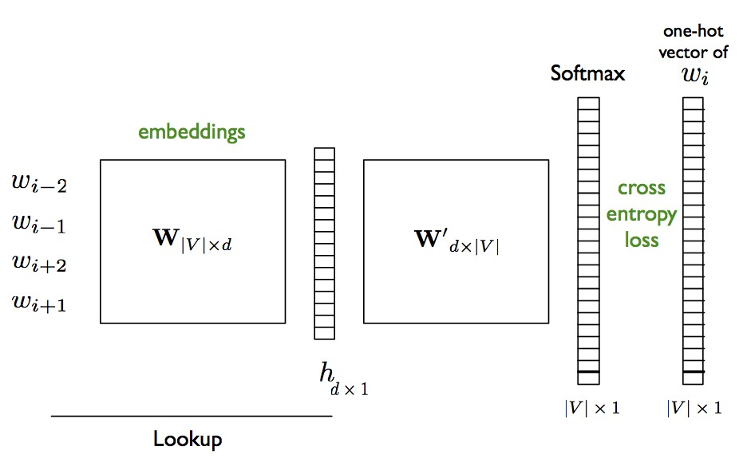

Slide 21
LSTM Neural Model
Word embedding + Neural networks
Train the word embedding + char embedding model.
Which then used to train the LSTM based neural network.
Try to do end to end training with both word embedding and Neural network simultaneously.
Dataset Processing
Word2Id Dictionary
Model
Parameter Tuning
Testing phase
Tokens
Word Embedding
Character Embedding
LSTM Network
Hidden States

Slide 22
Dual Embedded LSTM PosTagger
Model consist of the Word LSTM tagger , the Character LSTM Tagger and hidden states.
The LSTM takes in a sequence (words or characters), embeds the sequence into an embedding space (dimension of the space is a hyperparameter), and runs the LSTM model.
In current model, first the word level LSTM will take in a sequence of words and convert them into the word embedding space. Similarly, it will take the words sequentially and run the character level LSTM model, which will first take in the sequence of characters in each word and project it in the character embedding space and then run the LSTM model and take its hidden state and feed it back to the word LSTM model.
Using the character level hidden representation for every word as well as the word embedding, the word level model then runs LSTM on the sequence of words, and outputs the predictions for every tag.

Slide 23
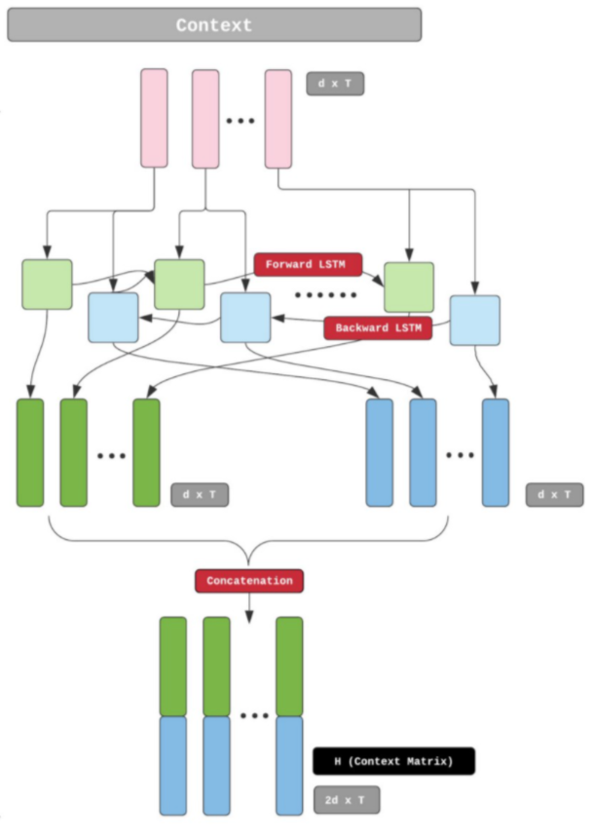
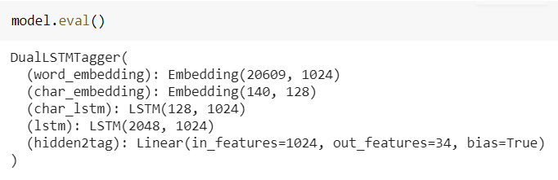
Model layers and Parameters
WORD_EMBEDDING_DIM = 1024
CHAR_EMBEDDING_DIM = 128
WORD_HIDDEN_DIM = 1024
CHAR_HIDDEN_DIM = 1024
EPOCHS = 50
Optimizer = Adam
Loss Function = Negative log Likelihood

Slide 24
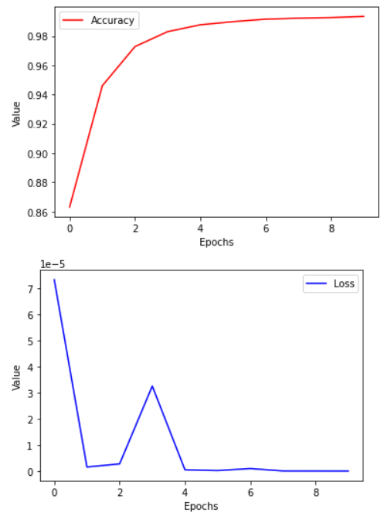
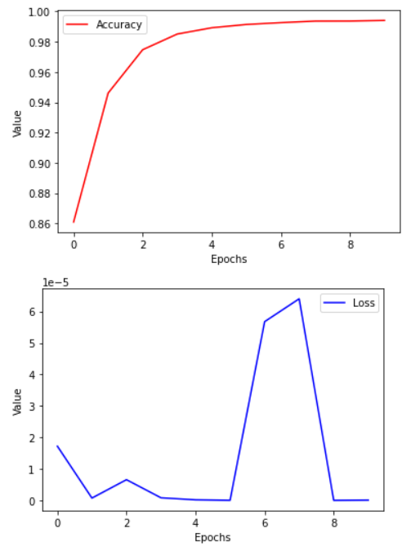
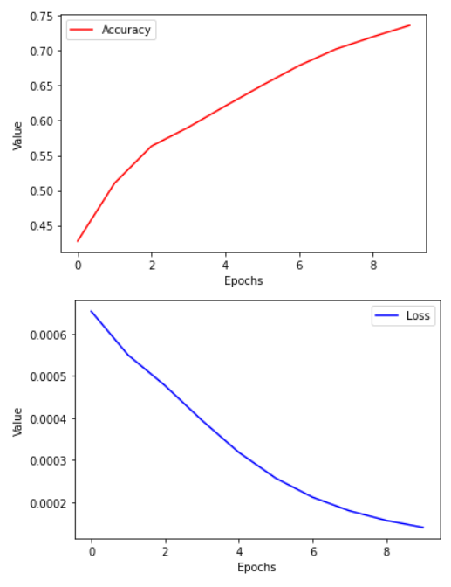
Hyper Parameter Tuning
ADAM Optimizer
RMSProp Optimizer
SGD Optimizer

Slide 25
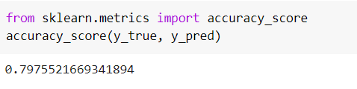
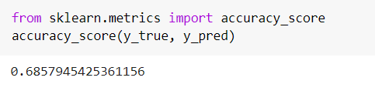
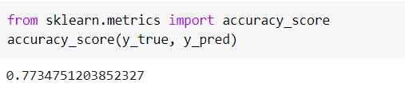
Validation test results
ADAM Optimizer
SGD Optimizer
RMSProp Optimizer

Slide 26
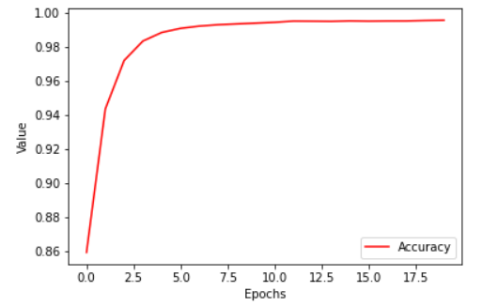
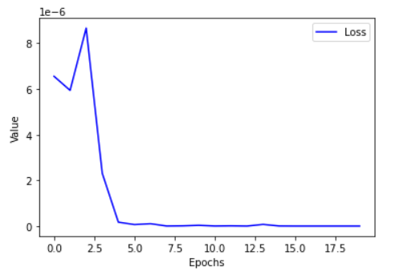
Final Accuracy and Loss Complete dataset

Slide 27
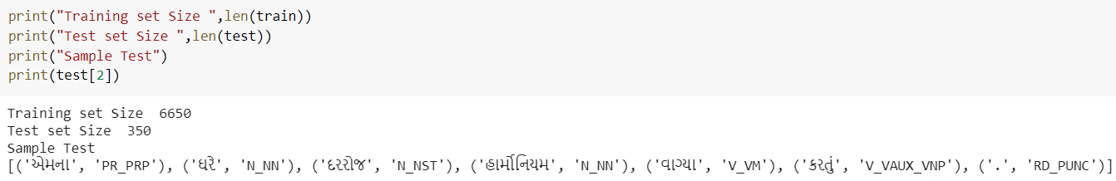
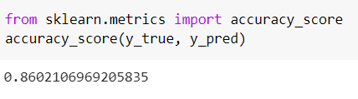
Final Test Data Results

Slide 28
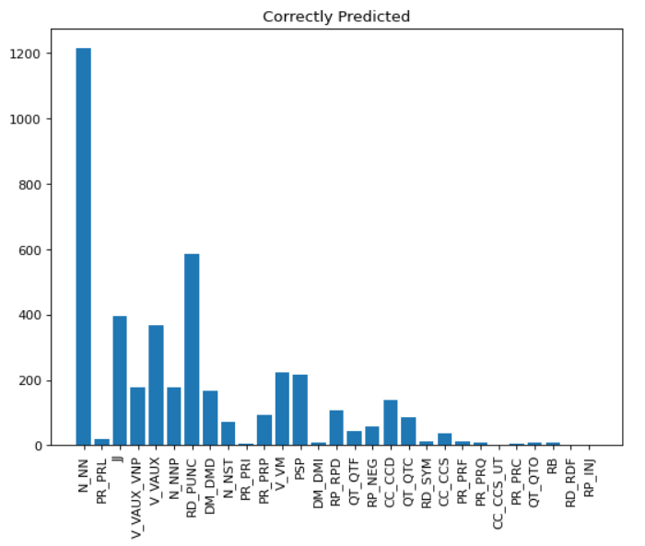
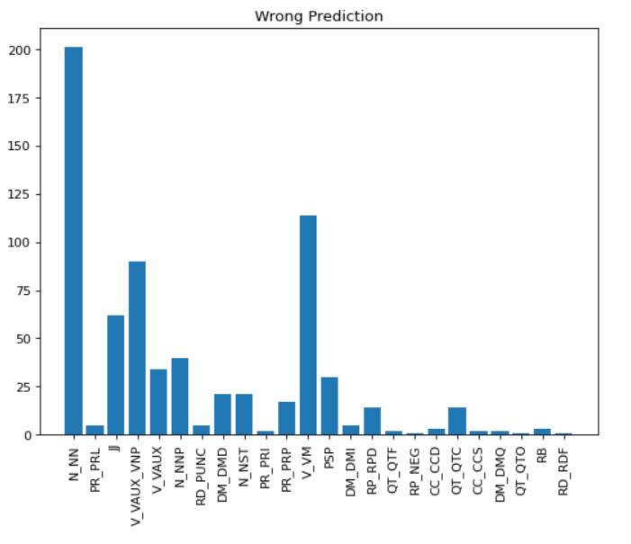
Correct vs Wrong Prediction

Slide 29
Row -> Actual Column -> Predicted

Slide 30
Dual Embedding + Bidirectional LSTM
Bidirectional LSTM are just putting two independent LSTMs together.
This structure allows the networks to have both backward and forward information about the sequence at every time step
Difference between unidirectional and Bidirectional LSTM is that in the LSTM that runs backward you preserve information from the future.
Using the two hidden states combined model is able to preserve information from both past and future at any point of time.

Slide 31
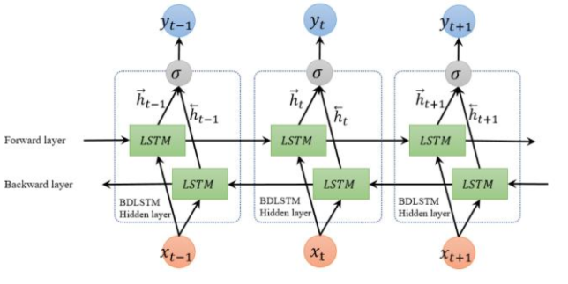
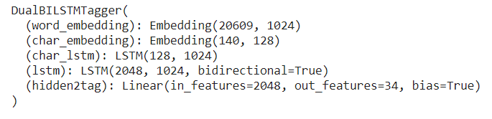
Model Details/Summary
WORD_EMBEDDING_DIM = 1024
CHAR_EMBEDDING_DIM = 128
WORD_HIDDEN_DIM = 1024
CHAR_HIDDEN_DIM = 1024
EPOCHS = 50
Optimizer = Adam
Loss Function = Negative log Likelihood

Slide 32
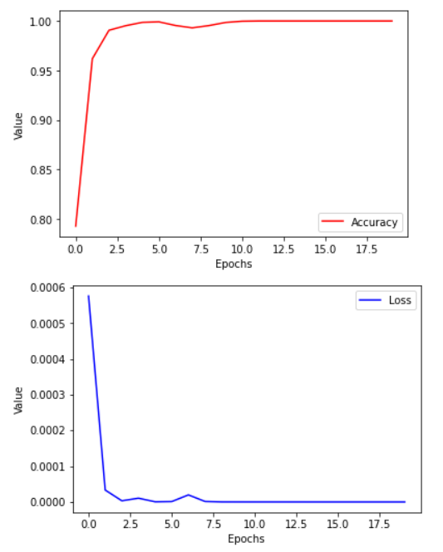
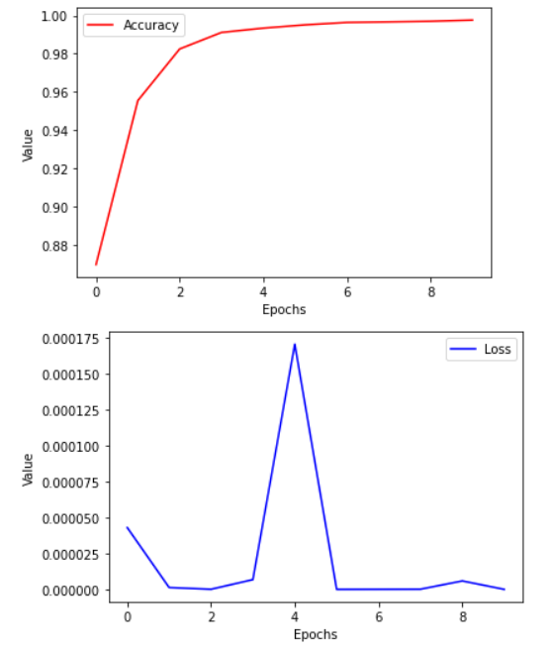
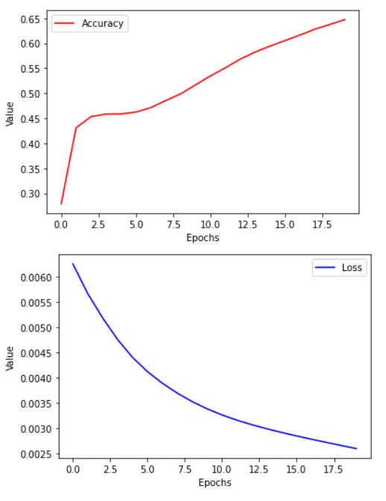
Hyper Parameter Tuning
ADAM Optimizer
RMSProp Optimizer
SGD Optimizer

Slide 33
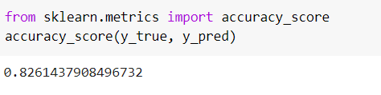
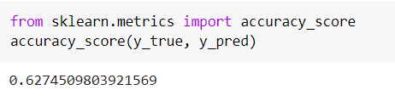
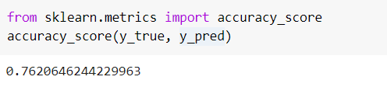
Test Set Results
ADAM Optimizer
SGD Optimizer
RMSProp Optimizer

Slide 34
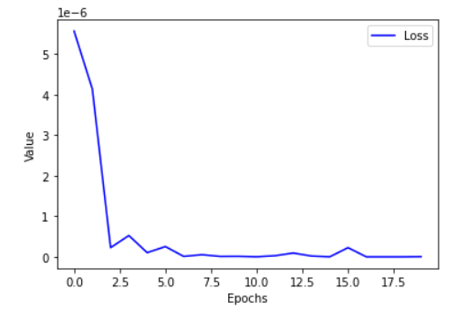
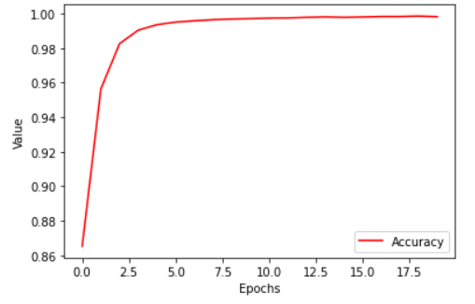
Final Accuracy and Loss Complete dataset

Slide 35
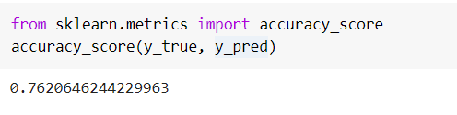
Test set Results Complete dataset

Slide 36
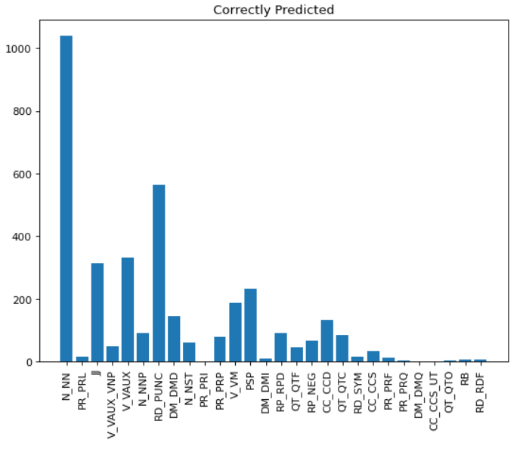
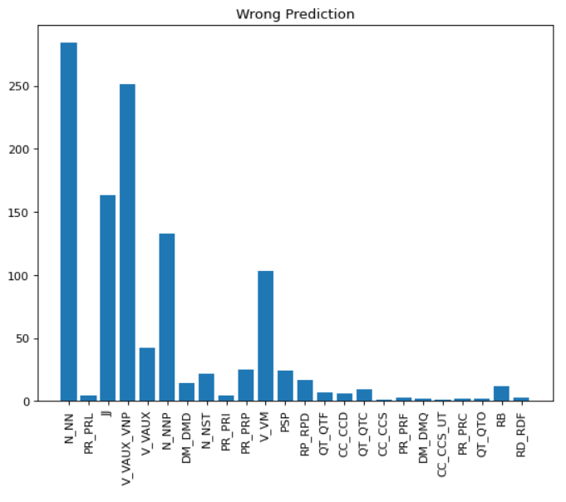
Correct vs Wrong prediction (Rmsprop)

Slide 37
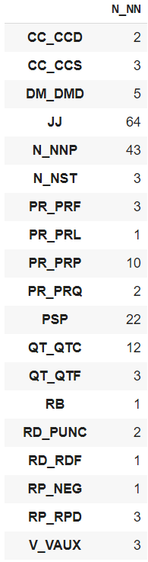
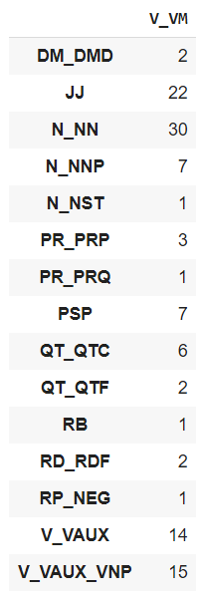
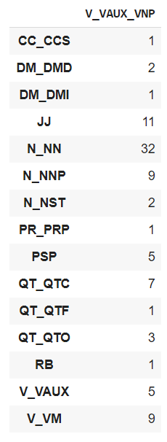
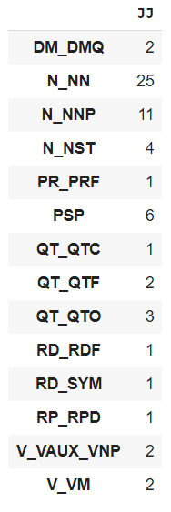
Error Analysis

Slide 38

Comparison Accuracy (Neural)

Slide 39

Comparison F1 score (Neural)

Slide 40

Comparison Recall (Neural)

Slide 41

Comparison Precision (Neural)

Slide 42

Accuracy (Neural vs Statistical) Test Data Set

Slide 43

F1Score (Neural vs Statistical) Test Data Set

Slide 44
Observations
Classical POS Tagging.
HMM gives good results compare to the CRF for the given datasets.
Though there are various factors which affects the accuracy of CRF Model like Selection of feature functions and proper preprocessing of the corpus to get good quality features to train CRF in proper manner.
Neural Models
Neural Models Almost outperforms the classical methods.
BiLSTM gives slightly batter results than LSTM , This is due to training of LSTM on both forward and backward sequences of POS Tags , which gives batter context information compare to the unidirectional LSTM

Slide 45
Future work or possible improvements
Preprocessing of Text – Some proper text preprocessing techniques specific to the Gujarati language can be leveraged which can transform Guajarati text into easily processable input. Like proper stemming and Lemmatization.
CRF Model can be improved by proper feature selection
Neural Model performance can be enhanced By adding Attention mechanism with the LSTM architecture. Which may give good improvement in case of long sequences of Corpus text.
Transformers can be experimented with the same data.

Slide 46
Summary
Implemented HMM and CRF as baseline model for POS Tagging over gujarati language.
For HMM, tried to optimize using Viterbi algorithm.
Used stemming techniques in CRF.
Build Dual LSTM POS-Tagger for gujarati language
Results Computed:
Accuracy and F1 Score comparison for all above models
Error analysis
Correct and Wrong prediction for each tag

